Slide 1

Introduction to NLP
Video 4: Methods of Text Preprocessing - Part 1

Slide 2
Text Classification Models
Instructor Video
Text Generation Models

Slide 3
Text Classification Models
Instructor Video
Segregate Based on context
Sentiment Analysis
Spam Detection
News Categorization, etc

Slide 4
Text Generation Models
Instructor Video
Generate text based on context
Text summarization
Autocomplete suggestions
Question Answering, etc

Slide 5
NLP Model
Text Classification Models
Bag of Words
Sequence

Slide 6
NLP Model
Text Classification Models
Bag of Words
Sequence

Slide 7
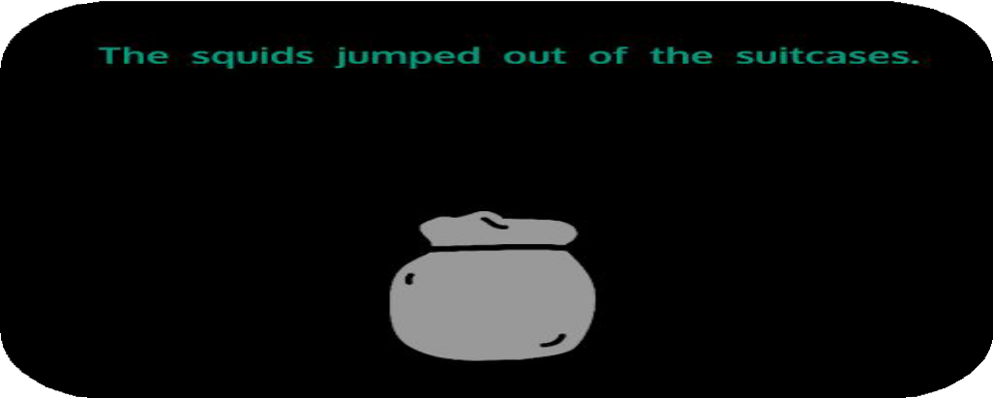
Bag of Words
Sentence or document is represented as the bag of its wordset.
Bag of words disregards grammar and sequence

Slide 8
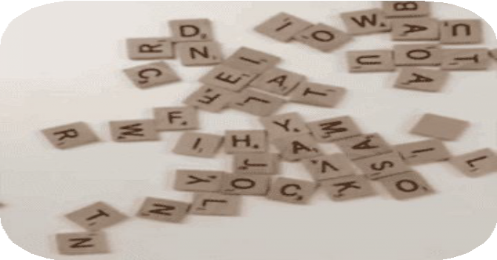
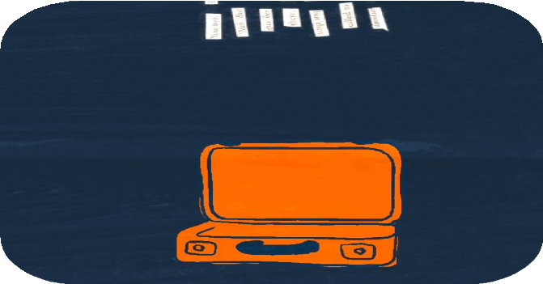
Bag of Words
Scrabble
Bag of Words

Slide 9
Tokenization
The process of dismantling the sentences, paragraphs and articles into smaller chunks is called tokenization .

Slide 10
Tokenization
NLP bridges the gap between human language and machines. It allow computers to understand the meaning behind words and generate human-like text. This powerful technology has a wide range of applications. NLP is constantly evolving, playing an increasingly important role in our interactions.
Sentence Tokenization
NLP bridges the gap between human language and machines.
It allow computers to understand the meaning behind words and generate human-like text.
This powerful technology has a wide range of applications.
NLP is constantly evolving, playing an increasingly important role in our interactions.

Slide 11
Tokenization
Hello world !
Character Tokenization
H
e
l
l
o
w
o r
l
d
!

Slide 12
Tokenization
Life is beautiful.
Word Tokenization
Life
is
beautiful
.
Tokens

Slide 13
Preprocessing Techniques

Slide 14

Preprocessing Techniques
Lowercasing

Slide 15
Preprocessing Techniques
Lowercasing
Removing Punctuation and Special Characters

Slide 16
Preprocessing Techniques
Lowercasing
Removing Punctuation and Special Characters Stop Words Removal

Slide 17
Preprocessing Techniques
Lowercasing
Removing Punctuation and Special Characters Stop Words Removal
Stemming and Lemmatization

Slide 18
Preprocessing Techniques
Lowercasing
Removing Punctuation and Special Characters Stop Words Removal
Stemming and Lemmatization Vocabulary Building

Slide 19
Preprocessing Techniques
Lowercasing
Removing Punctuation and Special Characters Stop Words Removal
Stemming and Lemmatization Vocabulary Building
Vectorization

